Slide 1
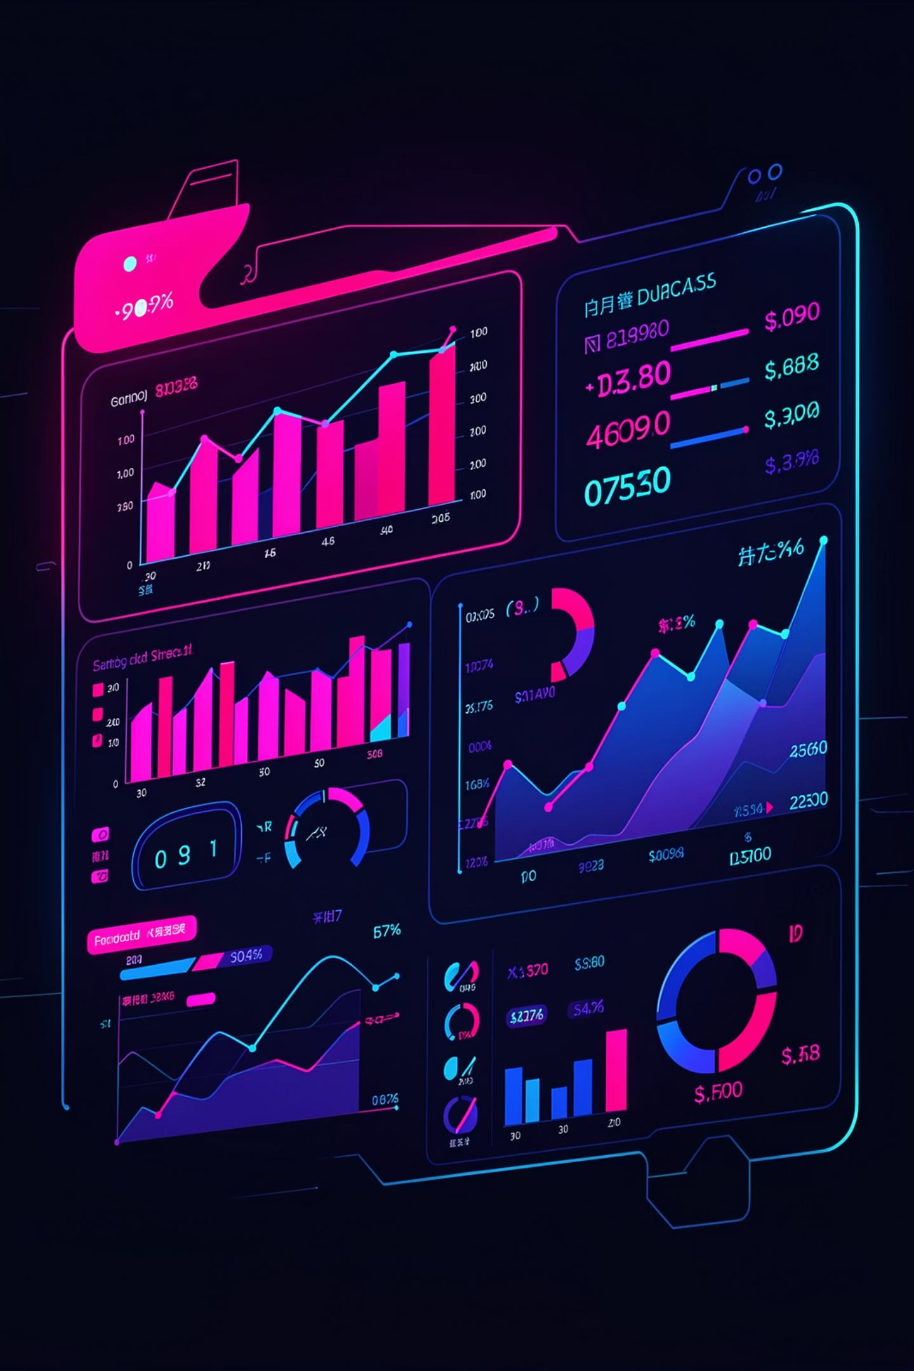
AI-Powered Personal Finance Tracker
Smart, Automated, and Secure Financial Management
Submitted by
Kunal Bagul
Swarupanand Deshmukh
Prathamesh Ghadge
31403
31411
31415

Slide 2

Introduction
The AI-Powered Personal Finance Tracker is a web-based application designed to efficiently manage financial activities in a digital environment — replacing manual methods with a structured, secure platform.
🔐 Secure Access
📊 Interactive Dashboard
Structured registration, login, and session management for all users.
Displays total income, expenses, and current balance using visual charts and graphs.
💾 Secure Database
All transaction details stored in a cloud database, improving accuracy and decision-making.

Slide 3

Motivation
Manual Methods Are Flawed
Notebooks and spreadsheets are time-consuming, difficult to maintain, and prone to human errors — missing entries and bad calculations are common.
Lack of Financial Awareness
Users struggle to analyze spending habits and identify overspending without proper visualization tools.
Web Advancements Enable Solutions
Modern web technologies make it possible to build a digital solution that provides real-time insights and is accessible from anywhere.

Slide 4

Project Objectives
1
2
Automate Record-Keeping
Full CRUD Operations
Replace manual tracking with an automated, accurate digital solution that reduces human error.
Enable Create, Read, Update, and Delete operations for all financial transactions.
3
4
Data Visualization
Secure Authentication
Provide dynamic dashboards and graphical charts to analyze financial patterns and spending behavior.
Develop a robust user authentication system to protect sensitive financial data.

Slide 5
Scope & Intended Audience
Project Scope
Who Is This For?
The system covers the following core areas:
Students managing pocket money and daily expenses.
Secure user management (registration, login, logout)
Transaction management for income and expenses
Dashboard analytics with real-time summaries
Chart visualizations for spending patterns
Cloud database storage for data persistence
Working professionals monitoring salary and monthly spending.
Small business owners needing simple financial records.
Individuals seeking to improve financial discipline and saving habits.

Slide 6
Functional Requirements
User Management
Transaction Controls
Secure Registration, Login, and Logout functionality with session handling.
Add, View, Update, and Delete income or expense records — including amount, category, and date.
Dashboard Display
Visual Analytics
Real-time calculation of total income, total expenses, and net balance displayed prominently.
Chart visualizations displaying graphical representations of spending patterns by category.

Slide 7





REQUIREMENTS
Non-Functional Requirements
Performance
Fast page loads and instant transaction processing for a seamless user experience.
Security
Secure login mechanisms and encrypted user data protection throughout the system.
Usability
Simple, intuitive, and highly responsive user interface across all device sizes.
Reliability & Scalability
Accurate data storage without loss, capable of handling an increasing number of users and transactions.

Slide 8
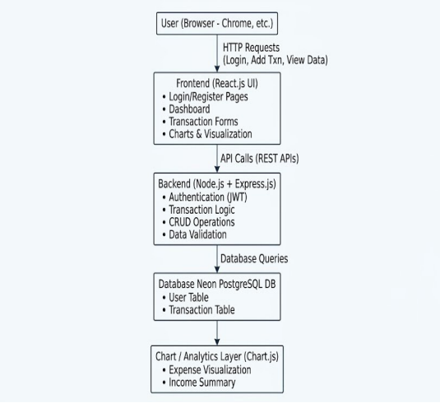
System Architecture & Tech Stack
📐 System Architecture Diagram
Technology Stack
Frontend
Backend
HTML, CSS, JavaScript, React.js
Node.js, Express.js
Database
Tools
Neon Database — secure, scalable cloud-based PostgreSQL
Git, GitHub, Postman for API testing

Slide 9
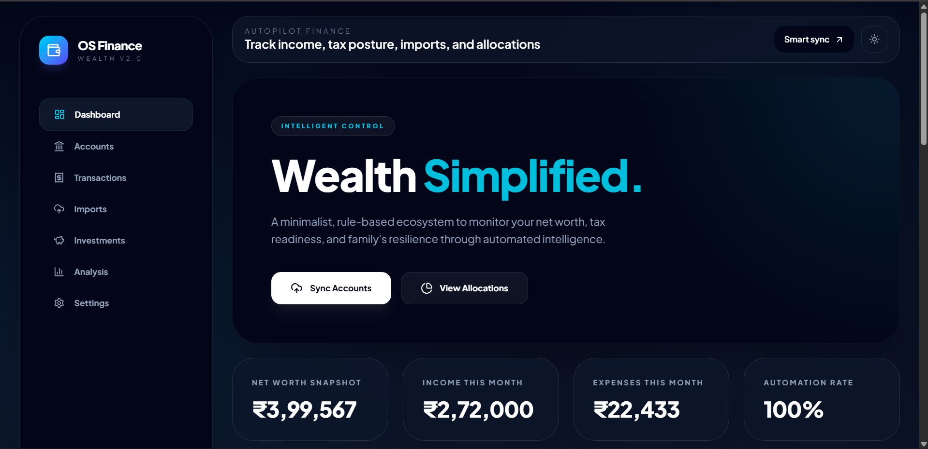

Implementation Details & UI
The system features a modern UI with distinct modules for tracking and analytics.
Core Screens Built
📸 Project Screenshots
Secure Sign Up / Sign In portals with validation
Main Dashboard — Recent transactions, tax estimates, and suggested tax regimes
Cashflow Analytics — Monthly income vs. expense graphs
Category Budgets — Food, Education, and Savings tracking
[STUDENT INSTRUCTION: PASTE YOUR SCREENSHOTS HERE ONCE GENERATED]
Sign-Up / Sign-In Screen
Main Dashboard View
Analytics & Charts Screen

Slide 10
Conclusion & Future Scope
✅ Conclusion
Successfully developed an efficient solution that replaces manual methods, reduces calculation errors, and securely stores data. The interactive dashboards significantly improve financial awareness for all users.
🚀 Future Enhancements
Integration of advanced budgeting tools with goal-based tracking.
Automated bank transaction syncing for real-time data updates.
Advanced AI-driven financial analytics and spending predictions.

